Slide 1
Tarun M
Team : tarun.mt_6994
EXL Hackathon :
A Smart BOT

Slide 2
Technologies Used:
Deep learning Chatbot to perform natural conversation and can provide useful information and provide interactive usage for the end users :
React : front end web app.
Chatbot UI : Botfront
Conversational AI : Rasa Opensource ( ' Roberta' - deep learning model for NLU )
haystack : NLP bsed Document search system for QnA fallback usage.
ElasticSearch : Storage of document embeddings which is utilised via HayStack

Slide 3
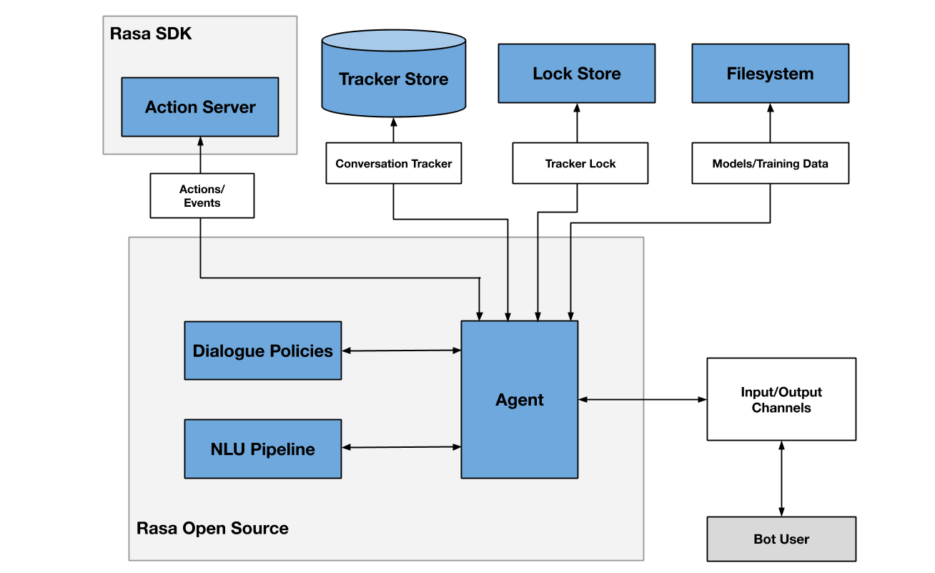

Solution Architecture
Haystack NLP Fallback server (FASTAPI)
When Questions not in Rasa trained model
Indexing pipeline
Search pipeline
Retrieved answer and context
File Converter
ElasticSearch
Reteriver
DocumentStore
Pre processor
Reader
Recommendations System
Recommendations in json fromat
React front-end UI
RASA websocket
BotFront chatbot UI
User Interaction

Slide 4
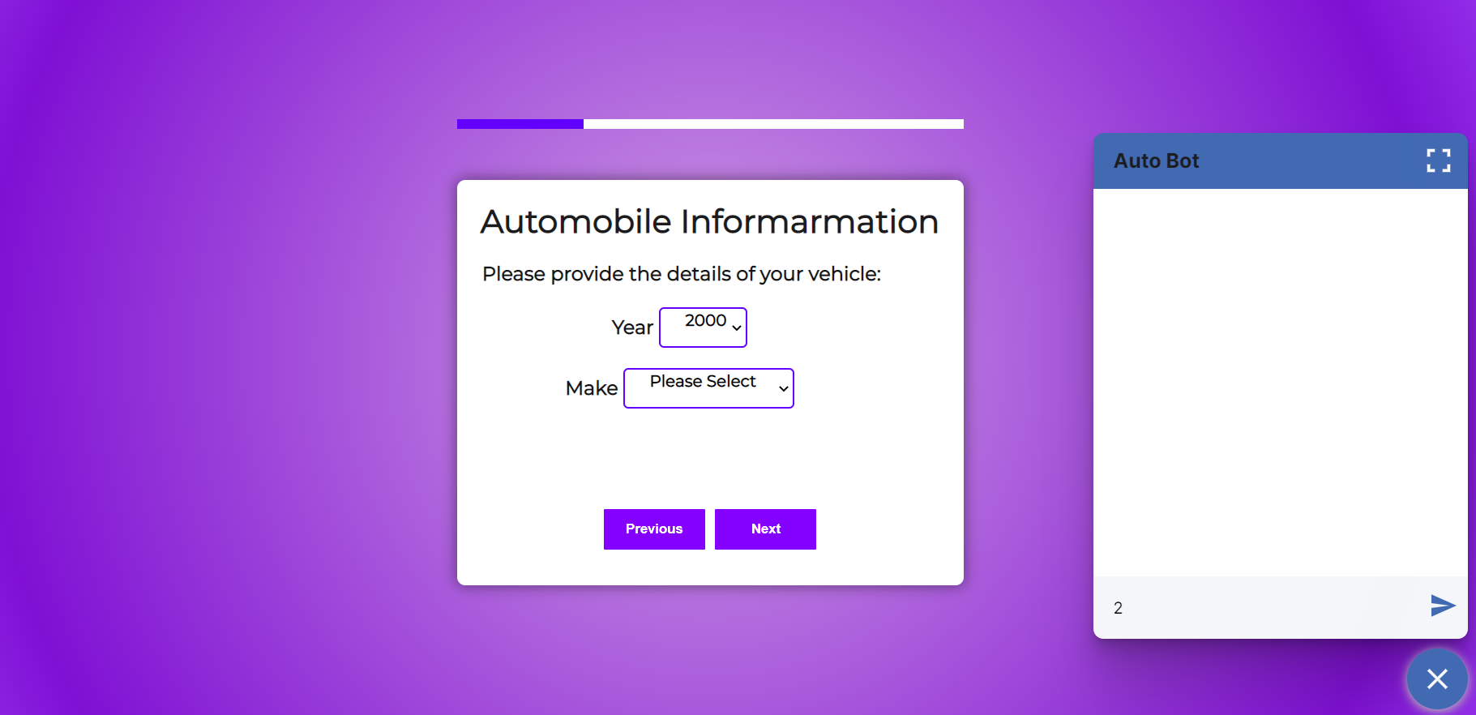
Methodology:
Front-end :
The web application form is
built using react(localhost:3000) .
Chatbot UI is built
using BotFront.
https://github.com/botfront/rasa-webchat

Slide 5
RASA Opensource:
RASA is used for NLU,Dialogue management,Entity extraction.
Deep learning Language model ‘Roberta’ is used for Intent Management and Entity extraction.
RASA utilises ‘Actions Server’(localhost:5505) to interact with information from the other applications ( Recommendations system, HayStack for NLP QnA tasks).
RASA exposes a webSocket API (localhost:5005) which is consumed by the BotFront UI.
RASA also exposes REST API which can used to update conversation flows, configs, re-train and update the chatbot models.https://rasa.com/docs/rasa/pages/http-api

Slide 6
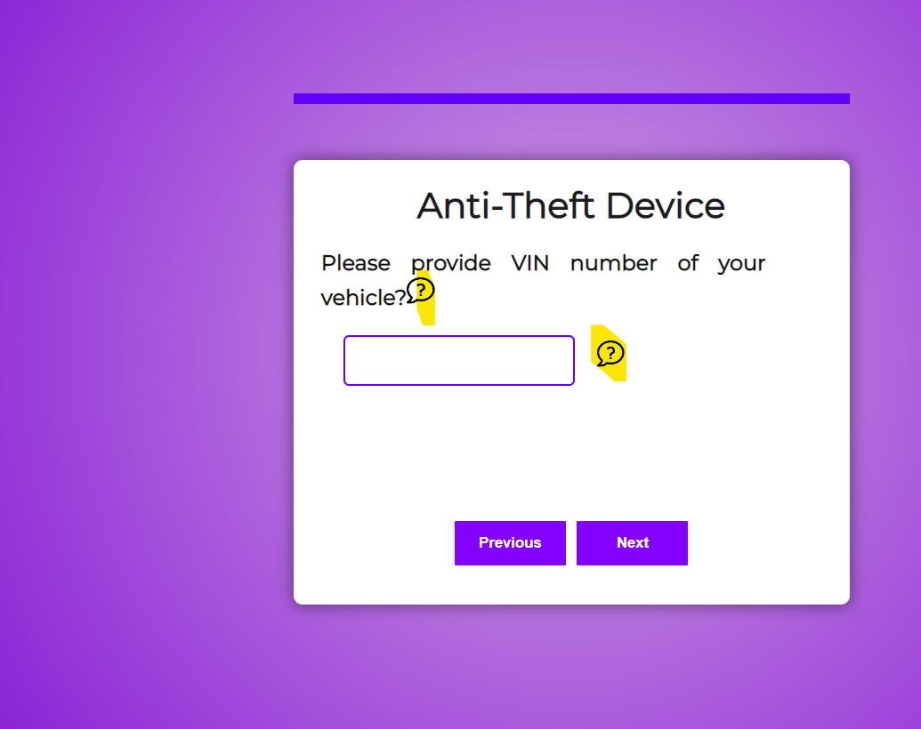
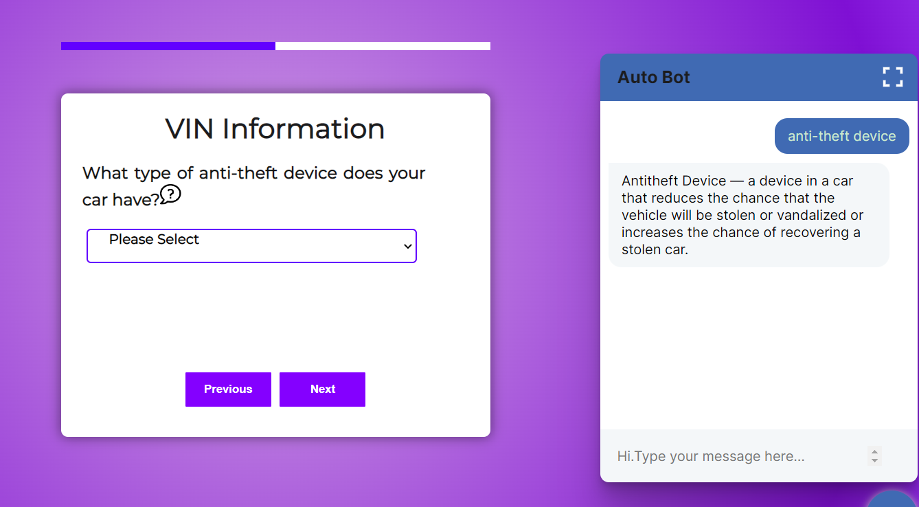
User Interactions with Chatbot
User can interact with the bot either by typing the chat window or click on the ‘?’ icon in the web page.
On clicking the ‘?’ icon a JavaScript is triggered, which initiates the chat for a particular field.

Slide 7
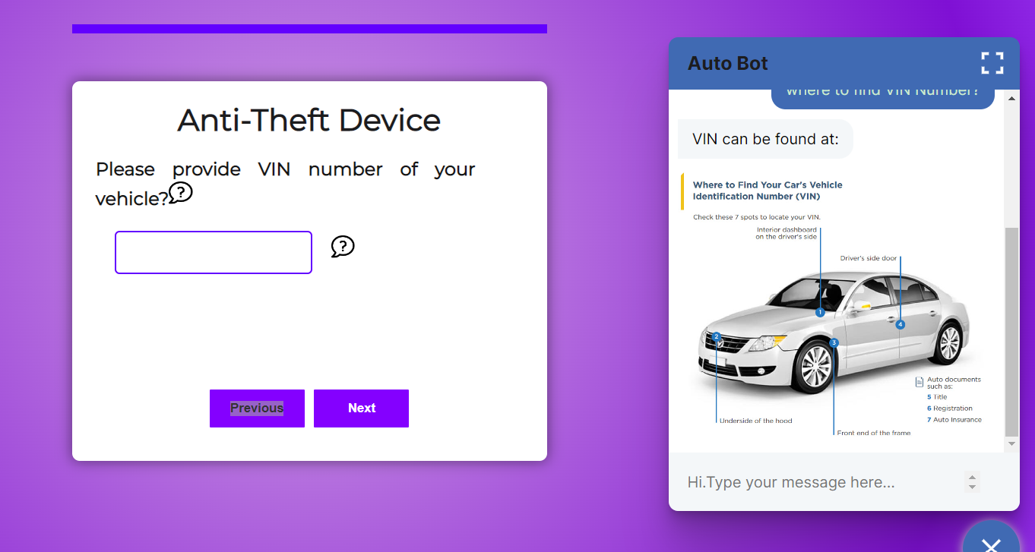
User Interactions with Chatbot (Contd. )
The responses for intents can also be of image type.

Slide 8
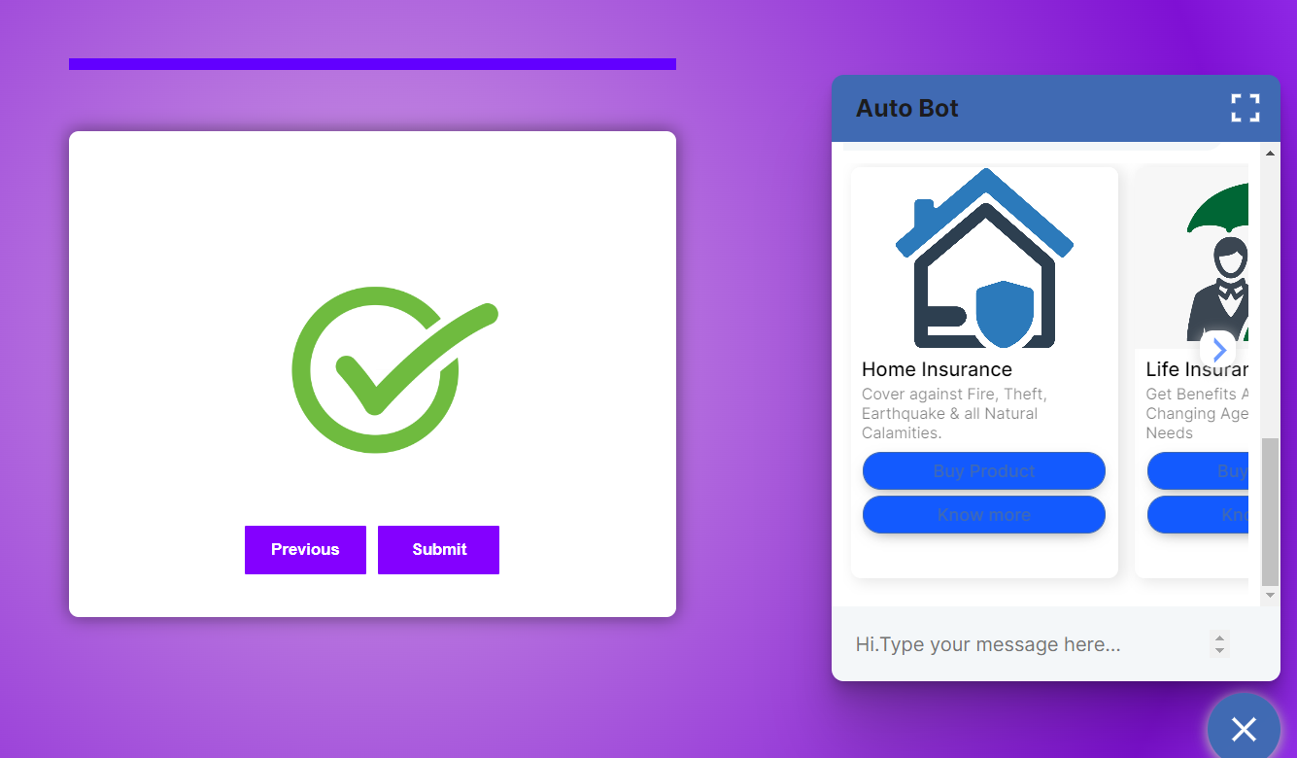
User Interactions with Chatbot (Contd. )
For product recommendations, the UI also shows up with interactive buttons and carousel for user interaction

Slide 9
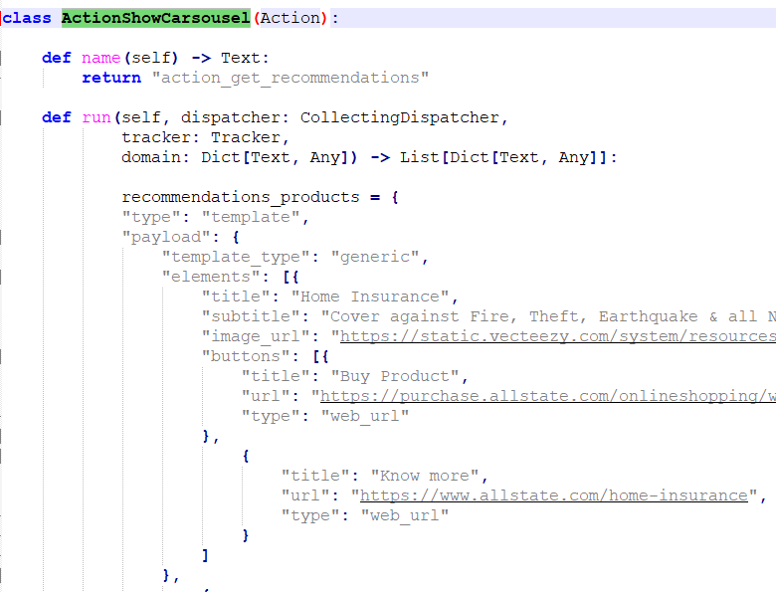
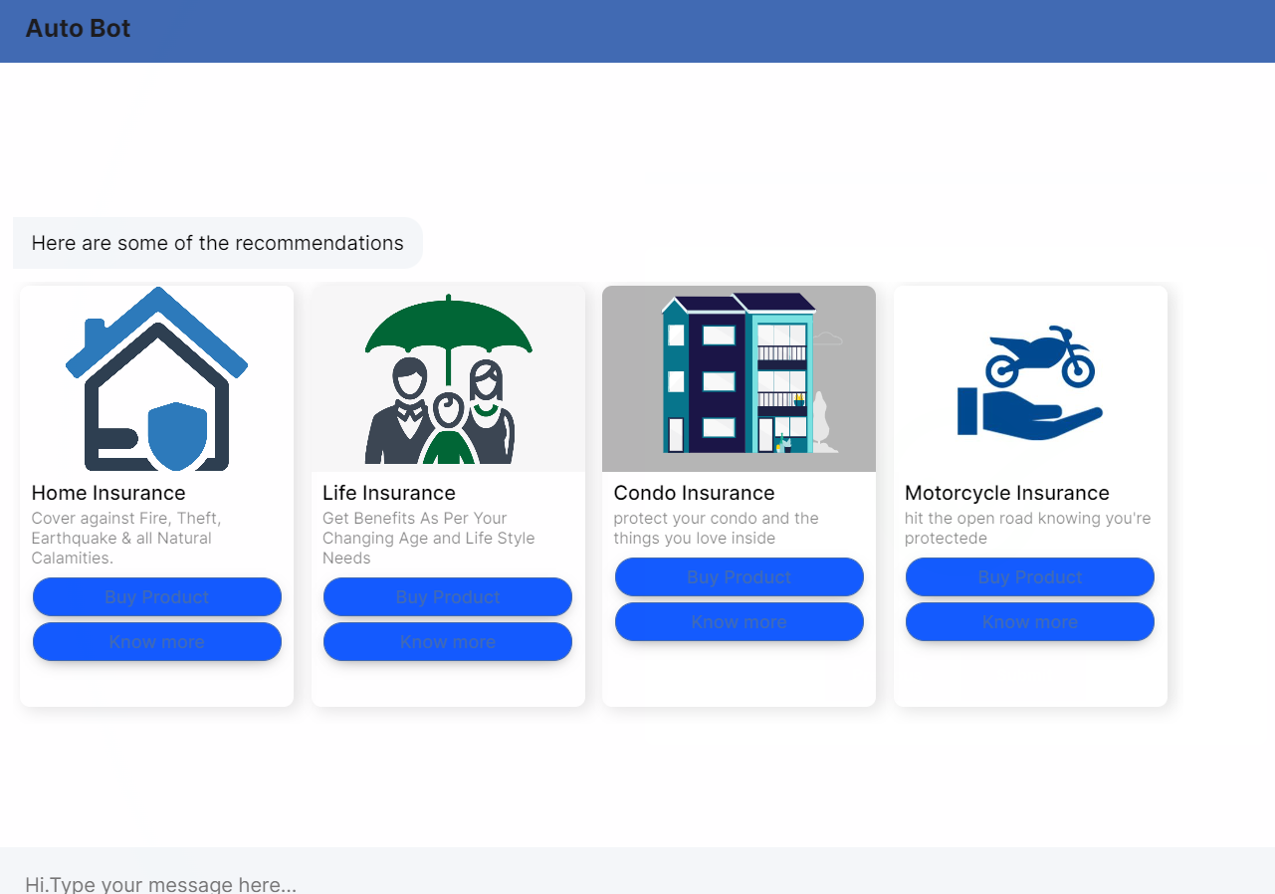
Product recommendations
RASA Interacts with Actions Server python class ‘ActionShowCarsousel’ in actions.py to get recommendations, currently it returns static json but can be fetch information as API.
Chatbot Font end UI(expanded)
Code snippet from actions.py

Slide 10
Fallback Server : Utilising Haystack NLP and Elasticsearch
Rasa stores responses in nlu.yaml and domain.yaml files for the predefined intents(questions) from the user.
For the questions which do not have pre-defined answers, RASA routes the query to HayStack NLP document search framework for answers ( via actions server).
Required document embeddings are generated and stored in the ElasticSearch document_store.
HayStack uses ‘Retriever’ and ‘Reader’ objects to search and reterive information ElasticSearch document_store index.

Slide 11
THANK YOU

